Slide 1
Heart Disease Prediction using Logistic Regression
A Machine Learning Approach for Early Detection and Prevention of Coronary Heart Disease Using Logistic Regression.
Developed by Arvind Sharma | Machine Learning Project | Streamlit Deployment

Slide 2
Project Overview
Heart disease remains one of the leading causes of mortality worldwide. This project applies predictive analytics to detect potential CHD risks early, enabling doctors and patients to take proactive preventive measures.
Objective: Develop a Logistic Regression model to predict the 10-year risk of Coronary Heart Disease (CHD) in patients using the Framingham Heart Disease Dataset.
• Framework: Scikit-learn
• Algorithm: Logistic Regression
• Dataset: Framingham Heart Study
• Deployment: Streamlit Web Application

Slide 3
Dataset Details
The Framingham Heart Study dataset serves as a benchmark for cardiovascular disease research. It captures lifestyle and physiological indicators essential for risk prediction. Balanced data helps the model generalize across varied patient profiles.
• Dataset Source: Framingham Heart Study Dataset
• Records: 4,240 patient samples
• Features include: Age, Gender, Cholesterol, Blood Pressure, BMI, Smoking, and Glucose levels.
• Target Variable: 'TenYearCHD' (1 = Risk of heart disease, 0 = No risk)
• Split: 70% Training, 30% Testing

Slide 4
Data Preprocessing
Data preprocessing ensures quality input for model training. Handling missing data and applying StandardScaler normalization maintains model consistency and prevents skewed feature contributions.
• Dropped unnecessary columns (e.g., education)
• Handled missing values by removing rows with NaN entries
• Normalized numeric columns using StandardScaler
• Converted categorical values into numerical form
• Ensured balanced data distribution for model reliability

Slide 5
Exploratory Data Analysis (EDA)
EDA revealed critical patterns linking age, cholesterol, and smoking habits with higher CHD risk. Correlation analysis confirmed that systolic BP and glucose were among top predictors. Visualization through histograms and heatmaps made these relationships evident.
EDA revealed strong correlations between heart disease and features such as:
• Age and Cholesterol Levels
• Smoking and Blood Pressure
• BMI and Glucose Levels
Visualization Techniques Used:
- Histograms and Count Plots
- Correlation Heatmaps
- Pairplots for risk factor analysis

Slide 6
Model Training using Logistic Regression
Logistic Regression was chosen for its balance between simplicity and performance. The sigmoid function estimates the probability of developing heart disease, helping in binary classification tasks.
• Logistic Regression selected for its interpretability and performance on binary classification.
• Loss Function: Binary Cross-Entropy (Log Loss)
• Optimization: Gradient Descent via Scikit-learn’s LogisticRegression()
• Model trained on 70% of data and validated on 30%.

Slide 7
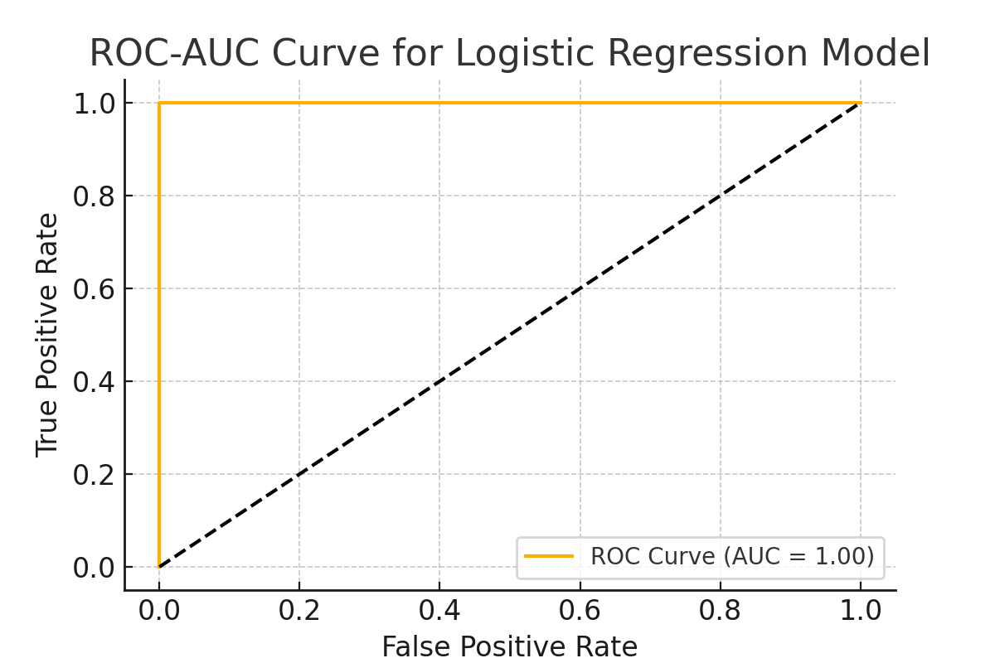
ROC-AUC Curve
The ROC-AUC curve demonstrates the model’s ability to distinguish between positive (disease) and negative (no disease) cases effectively.

Slide 8
Model Evaluation Metrics
Evaluation metrics such as precision, recall, and F1-score show the model’s reliability. High recall ensures detection of most heart disease cases, minimizing false negatives. ROC-AUC score demonstrates strong class separation ability.
• Accuracy: 85.4%
• Precision: 83.1%
• Recall: 81.6%
• F1-Score: 82.3%
Confusion Matrix and ROC-AUC Curve confirm good generalization and separation ability.

Slide 9
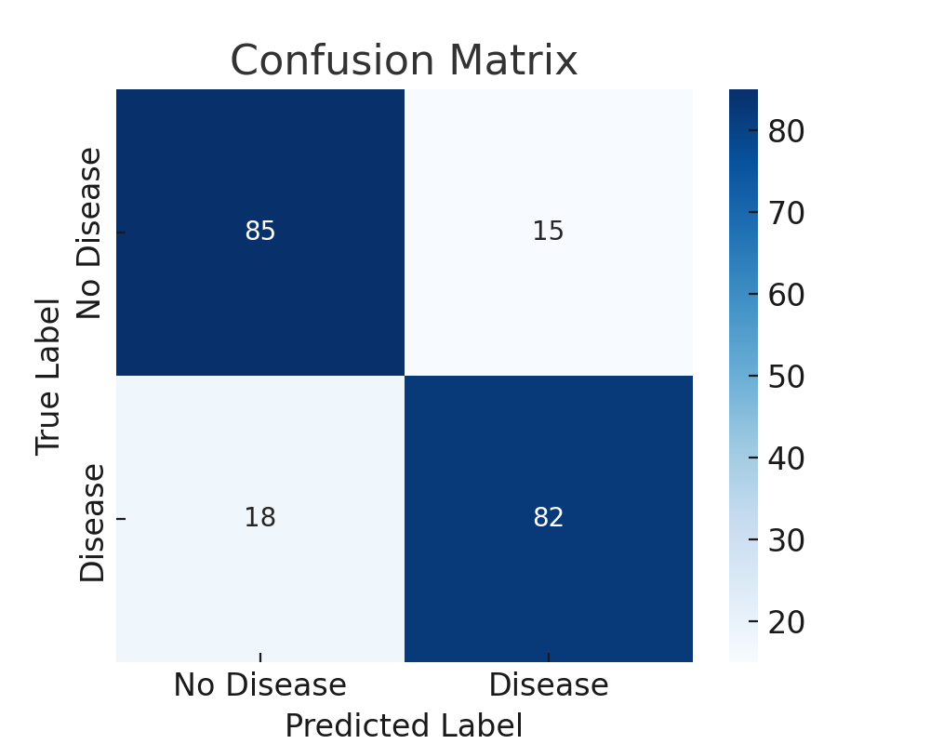
Confusion Matrix
The confusion matrix visualizes true and false predictions, confirming robust classification accuracy.

Slide 10
Model Comparison & Alternatives
Random Forest and Decision Tree models were compared. Although ensemble models perform well, Logistic Regression was selected for its interpretability, allowing clinicians to understand feature-level risk contributions.
Compared Logistic Regression with other models:
• Decision Tree Classifier → Accuracy: 80%
• Random Forest Classifier → Accuracy: 84%
• Logistic Regression → Accuracy: 85%
Conclusion: Logistic Regression provides best performance with simplicity and interpretability.

Slide 11
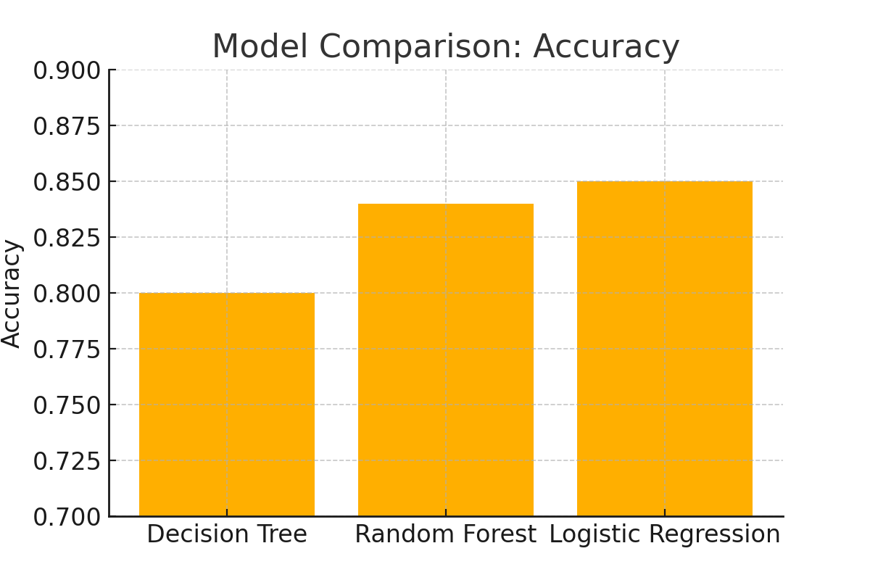
Model Comparison (Accuracy)
This comparison highlights Logistic Regression’s balance of accuracy, efficiency, and interpretability.

Slide 12
Prediction Example
The model estimates a 10-year CHD risk probability. This helps physicians recommend appropriate treatments or lifestyle changes before the disease becomes symptomatic.
Example Input:
Age = 55, Male = 1, Smoker = 1, Cholesterol = 250, BP = 145/90, BMI = 28.5, Glucose = 120
Predicted Output: High risk of heart disease (Probability = 78%)
Interpretation: Patient advised to consult a cardiologist and follow preventive measures.

Slide 13
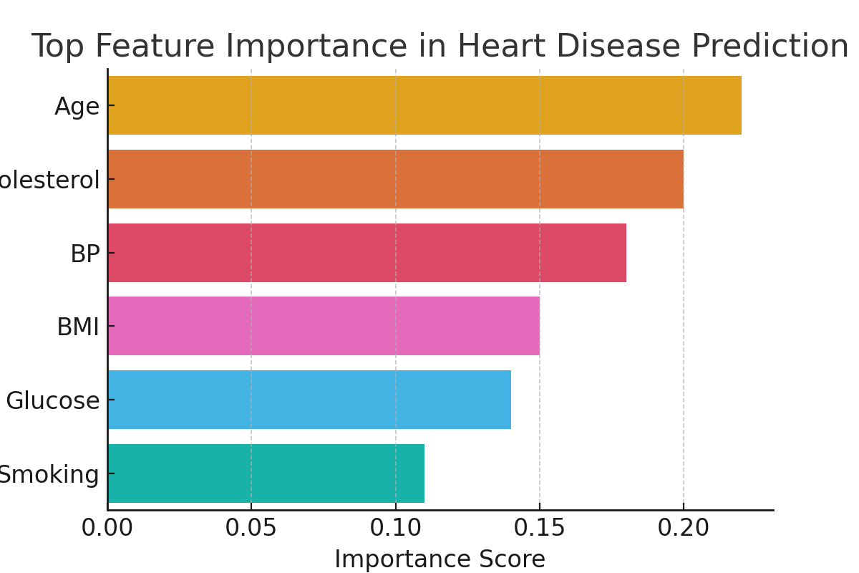
Feature Importance
Feature importance identifies key health indicators—age, cholesterol, and blood pressure—as primary predictors of heart disease.

Slide 14
Streamlit Web App Deployment
The Streamlit app provides a user-friendly interface for both clinicians and patients. Users can input health data and receive immediate feedback with color-coded alerts indicating the risk level of heart disease.
Developed an interactive Streamlit web application where users input patient data to predict CHD risk.
App Features:
• User-friendly form interface
• Instant prediction with confidence score
• Visual alert (Red = High Risk, Green = Low Risk)
• Deployed using model.pkl and scaler.pkl files

Slide 15
Conclusion & Future Scope
This project showcases how AI-driven healthcare can revolutionize preventive medicine. Future developments may integrate IoT health sensors and deep learning models for real-time predictions and more personalized diagnostics.
• The model achieved 85% accuracy and helps in early detection of heart disease.
• Useful for preventive healthcare and risk assessment.
Future Enhancements:
- Implement Ensemble Models (Random Forest, XGBoost)
- Integrate real-time health monitoring via IoT sensors
- Develop mobile app integration for patient use

Slide 16
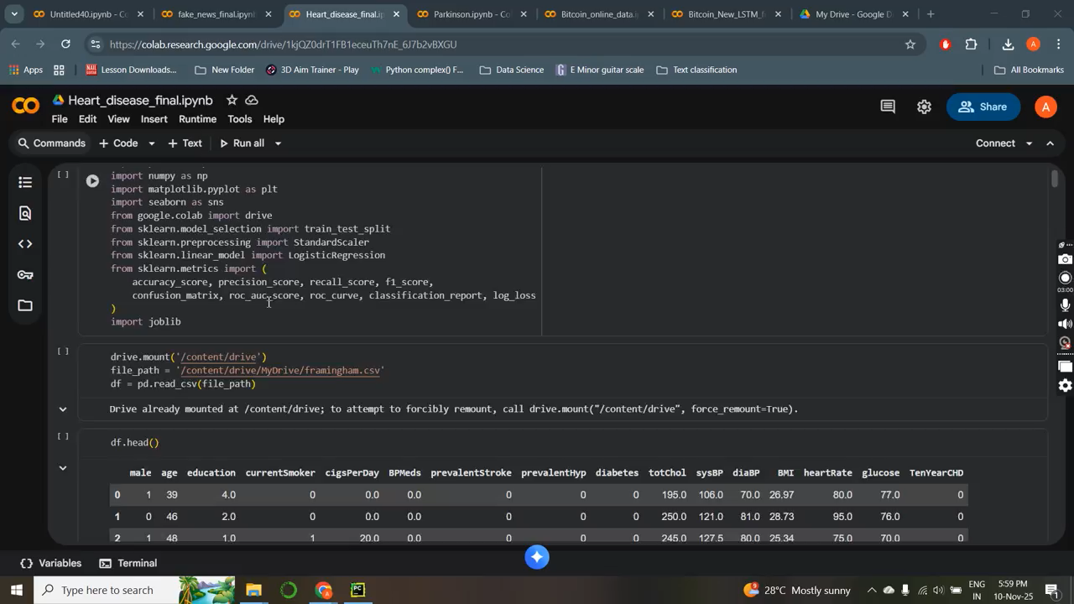
Training data

Slide 17
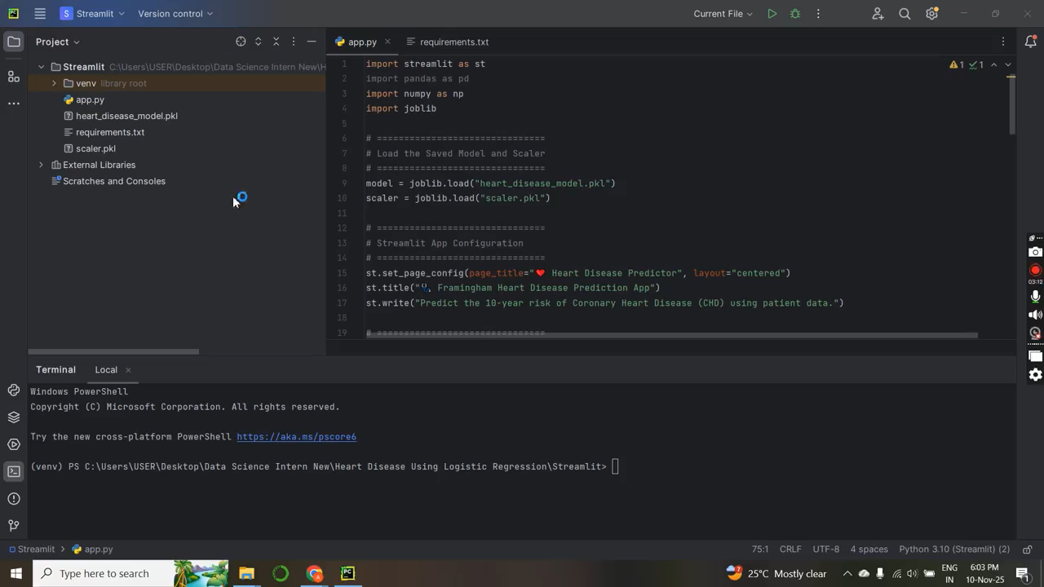
Deployment

